Slide 1
Review What We’ve Learned

Slide 2



Today’s Plans
Game Game Game

Slide 3
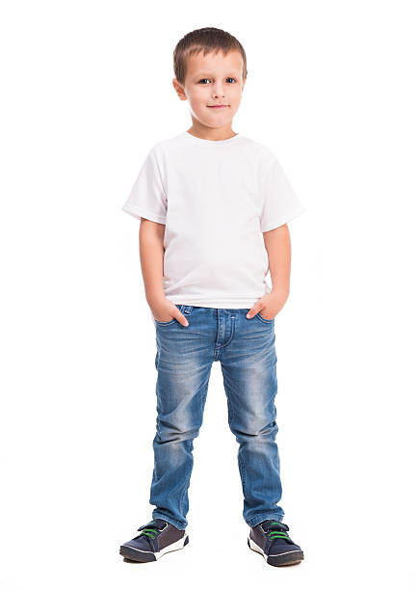
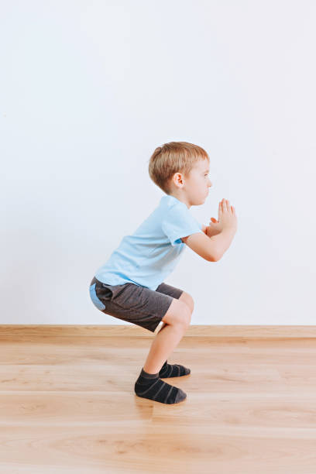
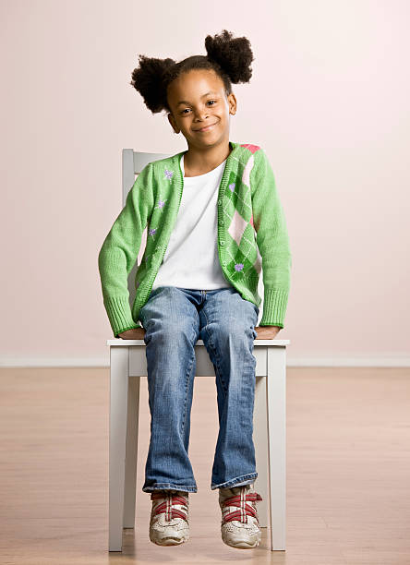
FruitSquat
Ms. Lin sit, Ms. Lin sit. Ms. Lin sat, and Jessica sit.

Slide 4

Use your eyes
Make eye contact to show that you want to take a turn

Slide 5
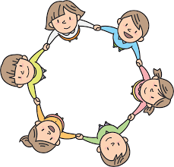


Who’s the Leader?

Slide 6
Do what others do

Slide 7
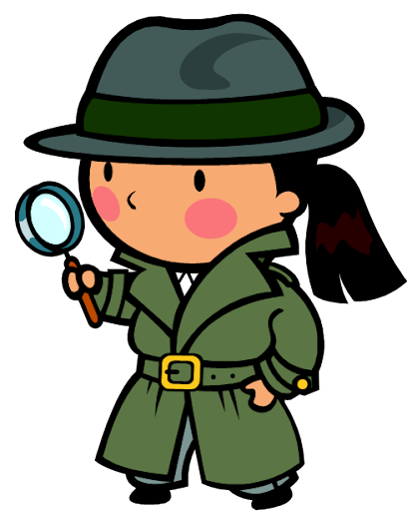
Become a detective

Slide 8
What clues can you find?
Let’s try it with the teachers first!
Who moves first?
Where are everyone’s eyes looking?

Slide 9


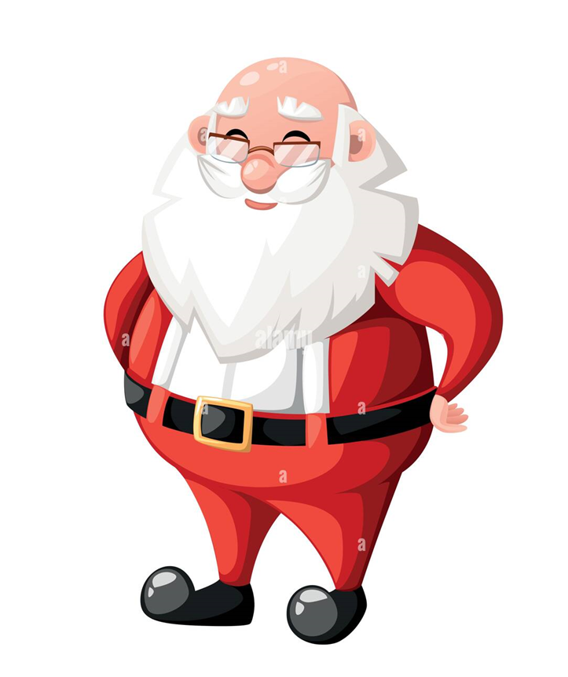

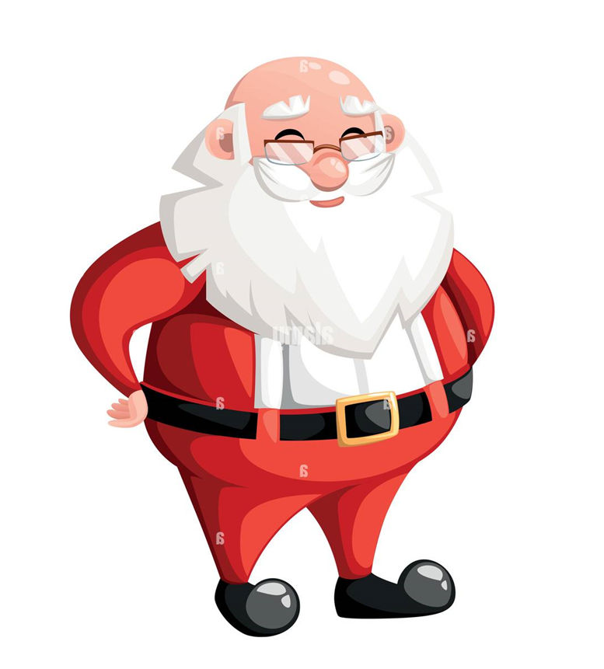
Santa Says

Slide 10
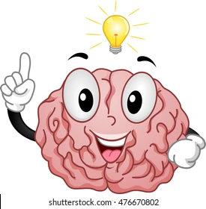

Use our eyes to think
Use our brains to think

Slide 11
Happy winter!

